Slide 1

Notepad Application using Java
A Practical Implementation of Data Structures

Slide 2
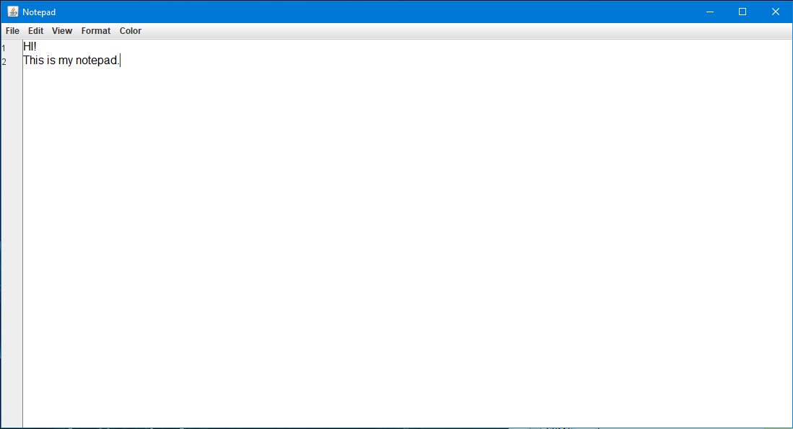
Project Objective
The main objective of our project is to develop a functional Notepad application using Java. This project is designed to showcase the practical implementation of key data structures—Stack, ArrayList, and HashMap—in a real-world application. By leveraging these data structures, we aimed to build a Notepad that not only allows users to edit text but also provides advanced features such as Undo/Redo, Line Finder, and Word Finder, making the application both powerful and user-friendly.

Slide 3
Data Structures Used - Stack
Stack
Purpose: Undo/Redo Functionality
The Stack data structure is central to implementing the Undo/Redo feature in our Notepad application. Stacks operate on a Last-In, First-Out (LIFO) principle, making them ideal for this functionality.
Explanation:
Undo: On every change, the current text state is pushed onto the Undo Stack. Undo pops the state, restoring the previous text and pushing it onto the Redo Stack.
Redo: Redo pops the state from the Redo Stack, reapplies it, and pushes it back onto the Undo Stack, allowing easy navigation through edits.

Slide 4

Feature Demonstration - Undo/Redo
How It Works: Undo/Redo
User Action: When the user makes a change, the current document state is saved.
Undo: The previous state is pushed to the Undo Stack. Selecting "Undo" pops this state from the stack, reverting the document.
Redo: If "Redo" is selected, the last undone state is popped from the Redo Stack, reapplied, and pushed back to the Undo Stack.
Cycle: This process repeats, allowing seamless back-and-forth navigation through edits.

Slide 5
Data Structures Used - ArrayList
ArrayList
Purpose: Line Finder
The ArrayList data structure is utilized for the Line Finder feature, which allows users to quickly navigate to a specific line within the document.
Explanation:
Each line is stored as an element in the ArrayList. When a user selects a line, the application accesses the element by its index, ensuring rapid navigation.
Efficiently handles the addition and deletion of lines, providing smooth interaction even with large documents.

Slide 6

Feature Demonstration - Line Finder
How It Works: Line Finder
ArrayList Structure: Each line of text is stored as an element in an ArrayList.
Efficient Navigation: Users can quickly navigate to a specific line by entering the line number. The ArrayList accesses the corresponding element by its index.
Quick Access: This feature allows for fast scrolling to any line, particularly useful in lengthy documents.
Performance: ArrayList offers O(1) time complexity for accessing elements, ensuring fast and reliable navigation.

Slide 7
Data Structures Used - HashMap
HashMap
Purpose: Word Finder
The HashMap data structure is used to implement the Word Finder feature, allowing users to search for specific words and quickly locate their positions in the text.
Explanation:
Words are mapped as keys, and their positions are stored as values. This allows for instant access to word locations without scanning the entire document.
When a user searches for a word, the HashMap returns its positions, enabling quick navigation or highlighting in the document.

Slide 8
Feature Demonstration - Word Finder
How It Works: Word Finder
HashMap Structure: Stores words as keys and their positions (numbers, indexes) as values.
Quick Search: When a user searches for a word, the HashMap quickly retrieves its locations.
Efficient Retrieval: HashMap offers O(1) time complexity for fast word lookup, even in large documents.
Multiple Occurrences: The HashMap efficiently handles and retrieves all occurrences of a word within the text.

Slide 9
Conclusion
Core Functionalities: Text editing with Undo/Redo, Line Finder, and Word Finder.
Data Structures Used:
Stack: Manages Undo/Redo operations.
ArrayList: Stores and navigates through lines of text.
HashMap: Enables quick word searches.
Team Collaboration: Enhanced teamwork, communication, and task management.
Project Management: Developed skills in planning, execution, and documentation.
Additional Features: Syntax highlighting, version control, and advanced search.
Performance Optimization: Improved memory management.

Slide 10

Q&A and End
Please feel free to ask about any of the features, data structures used, or the development process.
THANK YOU!

